Slide 1



RICHARDSON BAY
Regional agency
BAY CONSERVATION & DEVELOPMENT COMMISSION
ENFORCEMENT COMMITTEE
DECEMBER 14, 2023
rbra.ca.gov

Slide 2












Partners
rbra.ca.gov

Slide 3
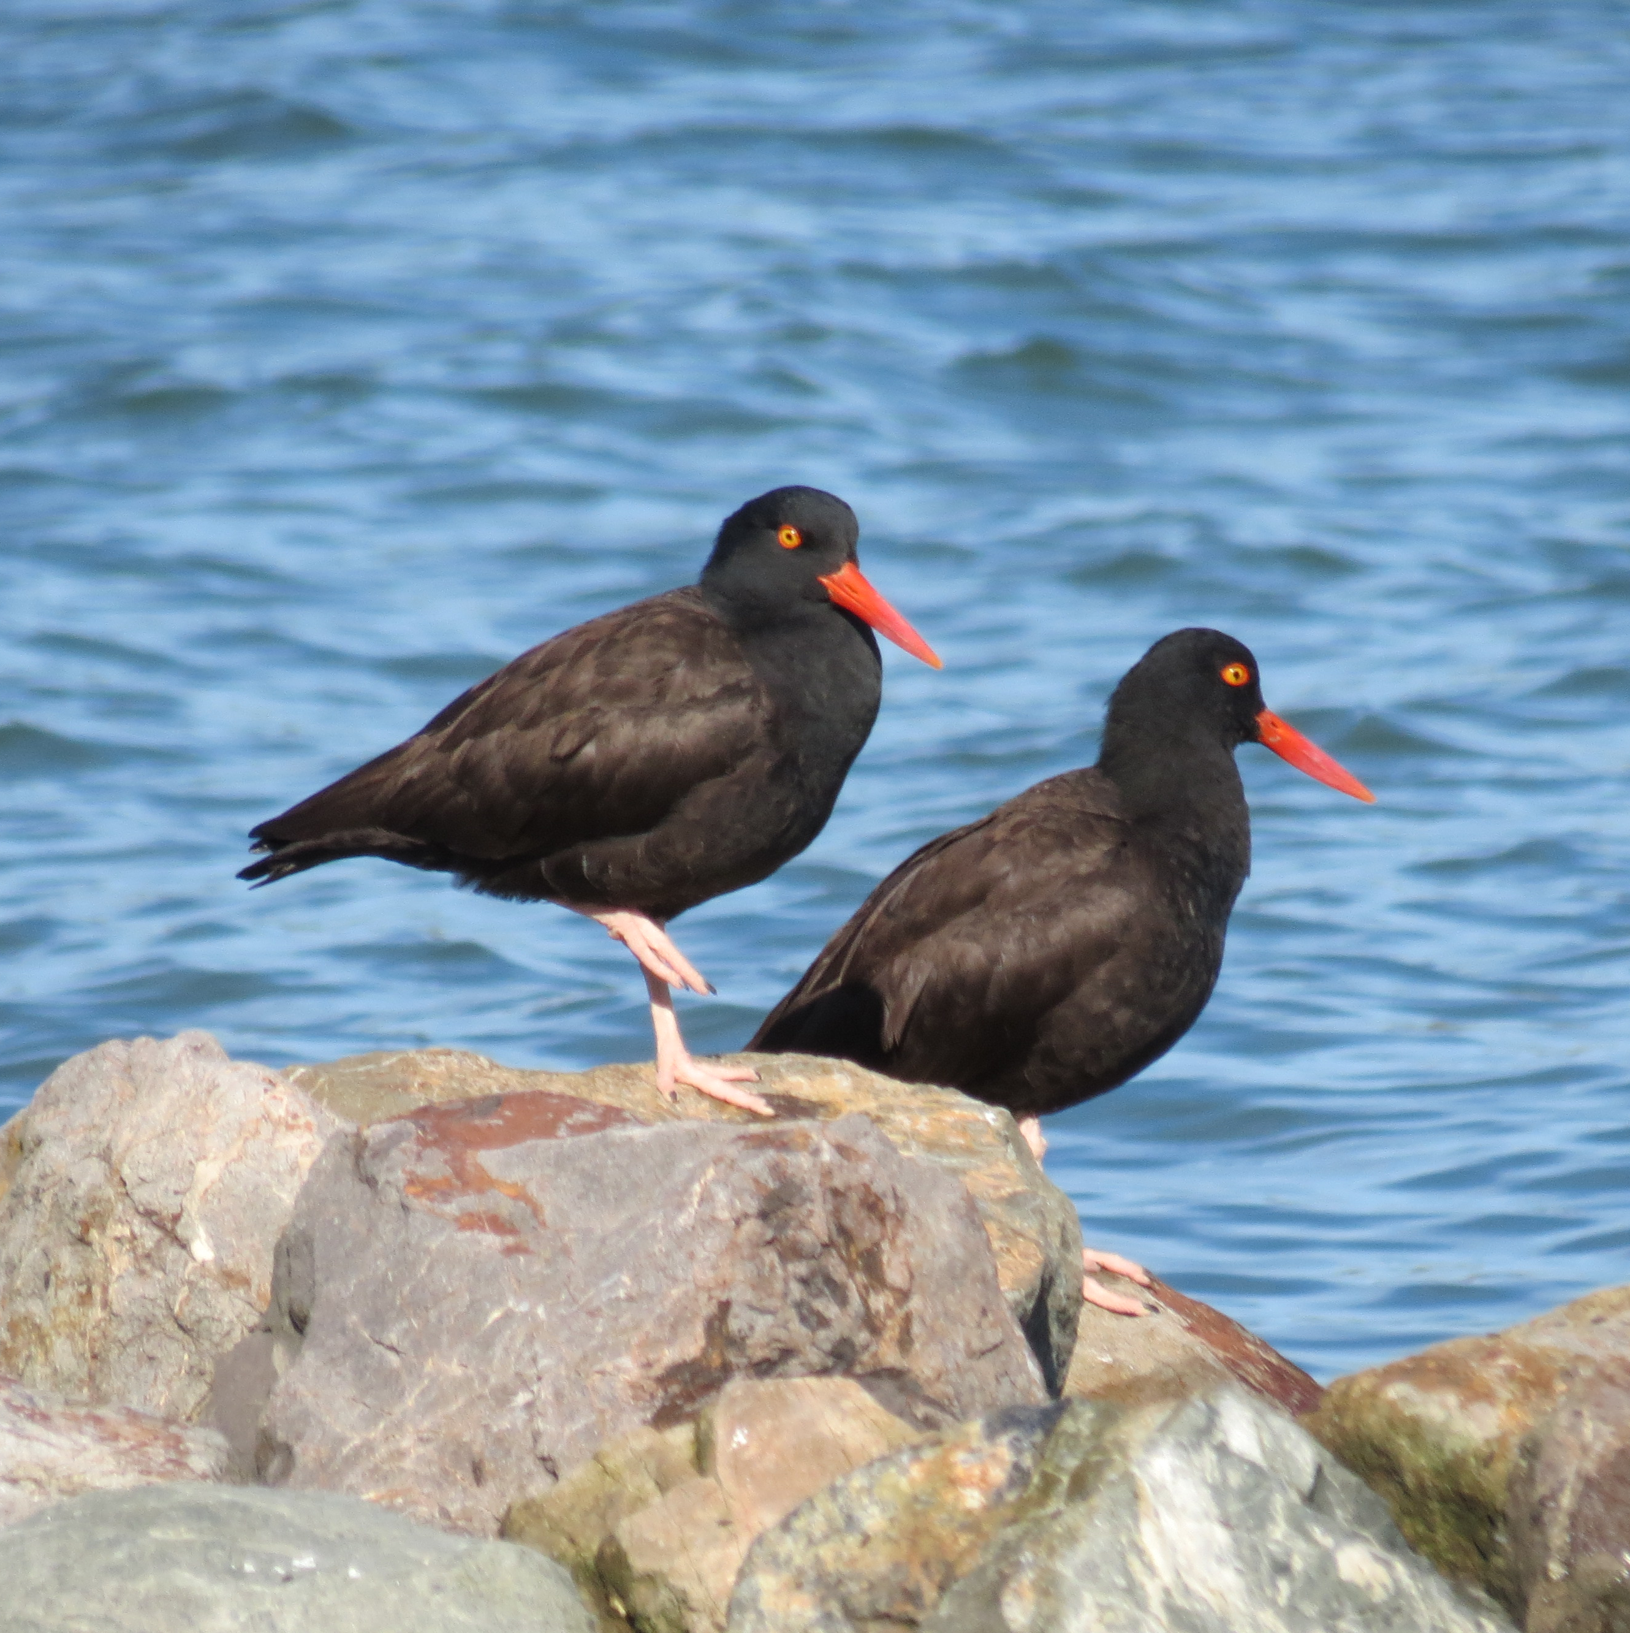
Milestones
rbra.ca.gov
Petition for any necessary federal action (60 days after final EPMP): 10/12/2021 (Done but Ongoing)
Remove all unoccupied marine debris: 10/15/2021 (Done but Ongoing)
Finalize Environmental Protection and Management Plan: 12/15/2021 (Done on 8/12/21)
No new vessels in Eelgrass Protection Zone (EPZ): 12/15/2021 (Ongoing)
Install 15 - 20 moorings in anchor zone: 12/15/2022 (On Hold)
Initiate eelgrass restoration studies: 12/31/2022 (Done)
Remove all post 8/19 vessels: 10/15/2023 Extension Requested and Approved to 10/15/2024
Remove all floating homes off Waldo Point: 10/15/2023. Two removed by deadline, one moved on 12/11/23 to legal floating home berth. The final vessel went through a nuisance abatement process for removal, and RBRA has requested one last additional 90-days to allow owner to repair and relocate the vessel

Slide 4
Milestones, Continued
rbra.ca.gov
Complete admin actions, update ordinances: 12/15/2023 (Done and USCG response received 5/18/23. Supporting order received from Judge Orrick on 12/1/23)
Begin implementation of 10-year adaptive management plan: 12/15/2023 (Notice to Proceed received 5/5/23. Plan will be submitted on 12/15/23)
No vessels in EPZ: 10/15/2024 EPZ signage program has been initiated.
Remove all occupied non-'Safe and Seaworthy': 10/15/2024. All vessels in this category have been provided a 12-month advance notice.
Apply for mooring permit from BCDC - prior to the end date and if desired: 10/15/2026
Remove all occupied 'Safe and Seaworthy': 10/15/2026
Removing all vessels and occupants: 10/15/2026
Only transient seaworthy vessels in anchor zone: 10/15/2026

Slide 5

Vessel buyback
PROGRAM
rbra.ca.gov
Past Reporting Period
ACTIVITIES DURING THIS REPORTING PERIOD
Approved by RBRA Board 6/23/22
9 vessels surrendered, $51,600 distributed
Program terminated 12/31/22
Will be brought back with housing support program
Program reinstated on 4/13/23 and will remain active to 10/15/26
Enough funding over the next three years to buyback most all the vessels in the anchorage
3 vessels purchased since 4/13/23
5 Vessels purchased and properly disposed of during this reporting period
One floating home purchased and disposed of during this reporting period.
8 total vessels purchased and properly disposed of since the reinstatement of the program since 4/13/23
$39,700 distributed since reinstatement of program
$81,700 distributed and 21 vessels properly disposed of since program inception in 2022

Slide 6
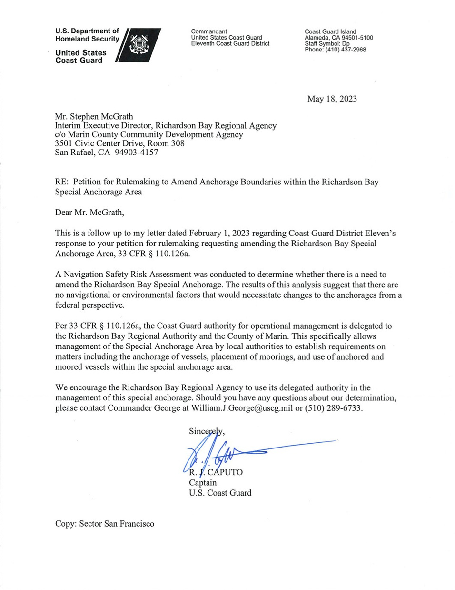
Codes and ordinances
rbra.ca.gov
Past reporting period
Code of Federal Regulations – petition for amendment submitted to USCG on December 14, 2022; receipt acknowledged February 1, 2023
Response received from U.S. Coast Guard on 5/18/23
CFR section 110.126a, the Coast Guard authority for operational management is delegated to the Richardson Bay Regional Authority and the County of Marin.
This specifically allows the management of the Special Anchorage Area by local authorities to establish requirements on matters including the anchorage of vessels, placement of moorings, and use of anchored and moored vessels within the special anchorage area.

Slide 7
Legal opinion
rbra.ca.gov
Defendants also contend that throughout the FAC Roark argues or implies that RBRA’s anchorage ordinance is preempted by federal law. See, e.g., FAC ¶ 145 (“anchoring permit application violates the Supremacy Clause because it effectively bans all anchoring within the federally designated anchorage outlines in 33 C.F.R. 110.126(a)”). I agree that no regulation or federal authority identified by Roark preempts the authority of RBRA to control anchorages in Richardson’s Bay. Instead, the federal regulations he identified establish Richardson’s Bay as a “special anchorage area” and direct mariners to comply with the RBRA’s Permit Scheme. Significantly, the Ninth Circuit has expressly rejected the argument that the special anchorage designations conflict with local ordinances requiring permits to stay beyond 72 hours.
On December 1. 2023 Judge William H Orrick provided an order to dismiss without leave to amend, a claim against RBRA with language that supports RBRA’s position and codes regarding Richardson Bay.
When CFR 33.110.126(a) was identified, the Judge opined the following

Slide 8
Legal opinion,
CONTINUED
rbra.ca.gov
But I agree that to the extent Roark is alleging a stand-alone constitutional entitlement to anchor where he chooses, the United States’ constitution does not confer a blanket right to anchor in Richardson’s Bay. See Graf v. San Diego Unified Port Dist., 7 Cal. App. 4th 1224, 1232 (1992) (“Boaters do not have a constitutional right to unregulated long-term anchorage in public navigable waters.”).
Defendants argue that Roark lacks standing to bring a procedural due process claim because he has not applied for a Permit (Mot. at 8-9) and admits that he intends to live on his boat in Richardson’s Bay, which is not allowed under RBRA Code §3.04.020 and means that he would be denied a Permit. See Mot. at 8-9; RBRA Code 3.04.020 (“Living aboard a houseboat or vessel anchored or moored in Richardson’s Bay is prohibited.
Although this opinion is still subject to appeal, it mentions more than once, regarding anchoring and living aboard on Richardson Bay.

Slide 9
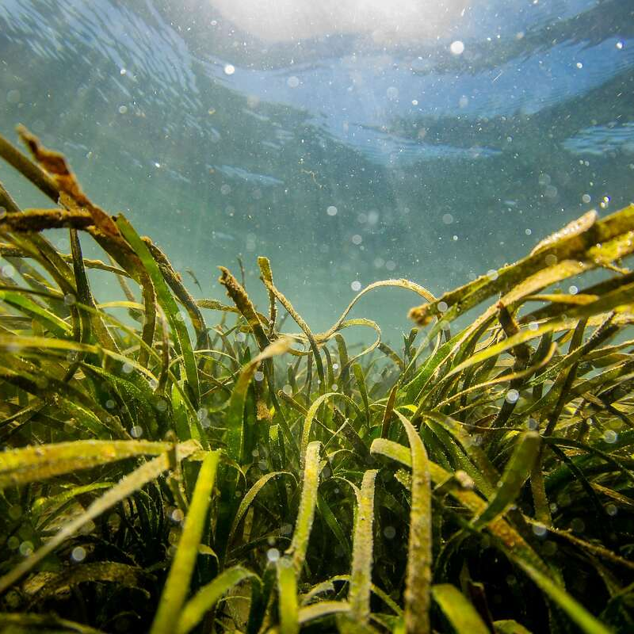
RBRA Update: EELGRASS
rbra.ca.gov
EPA Restoration Grant
2023 Monitoring Update
Photo: Brian Fulner

Slide 10
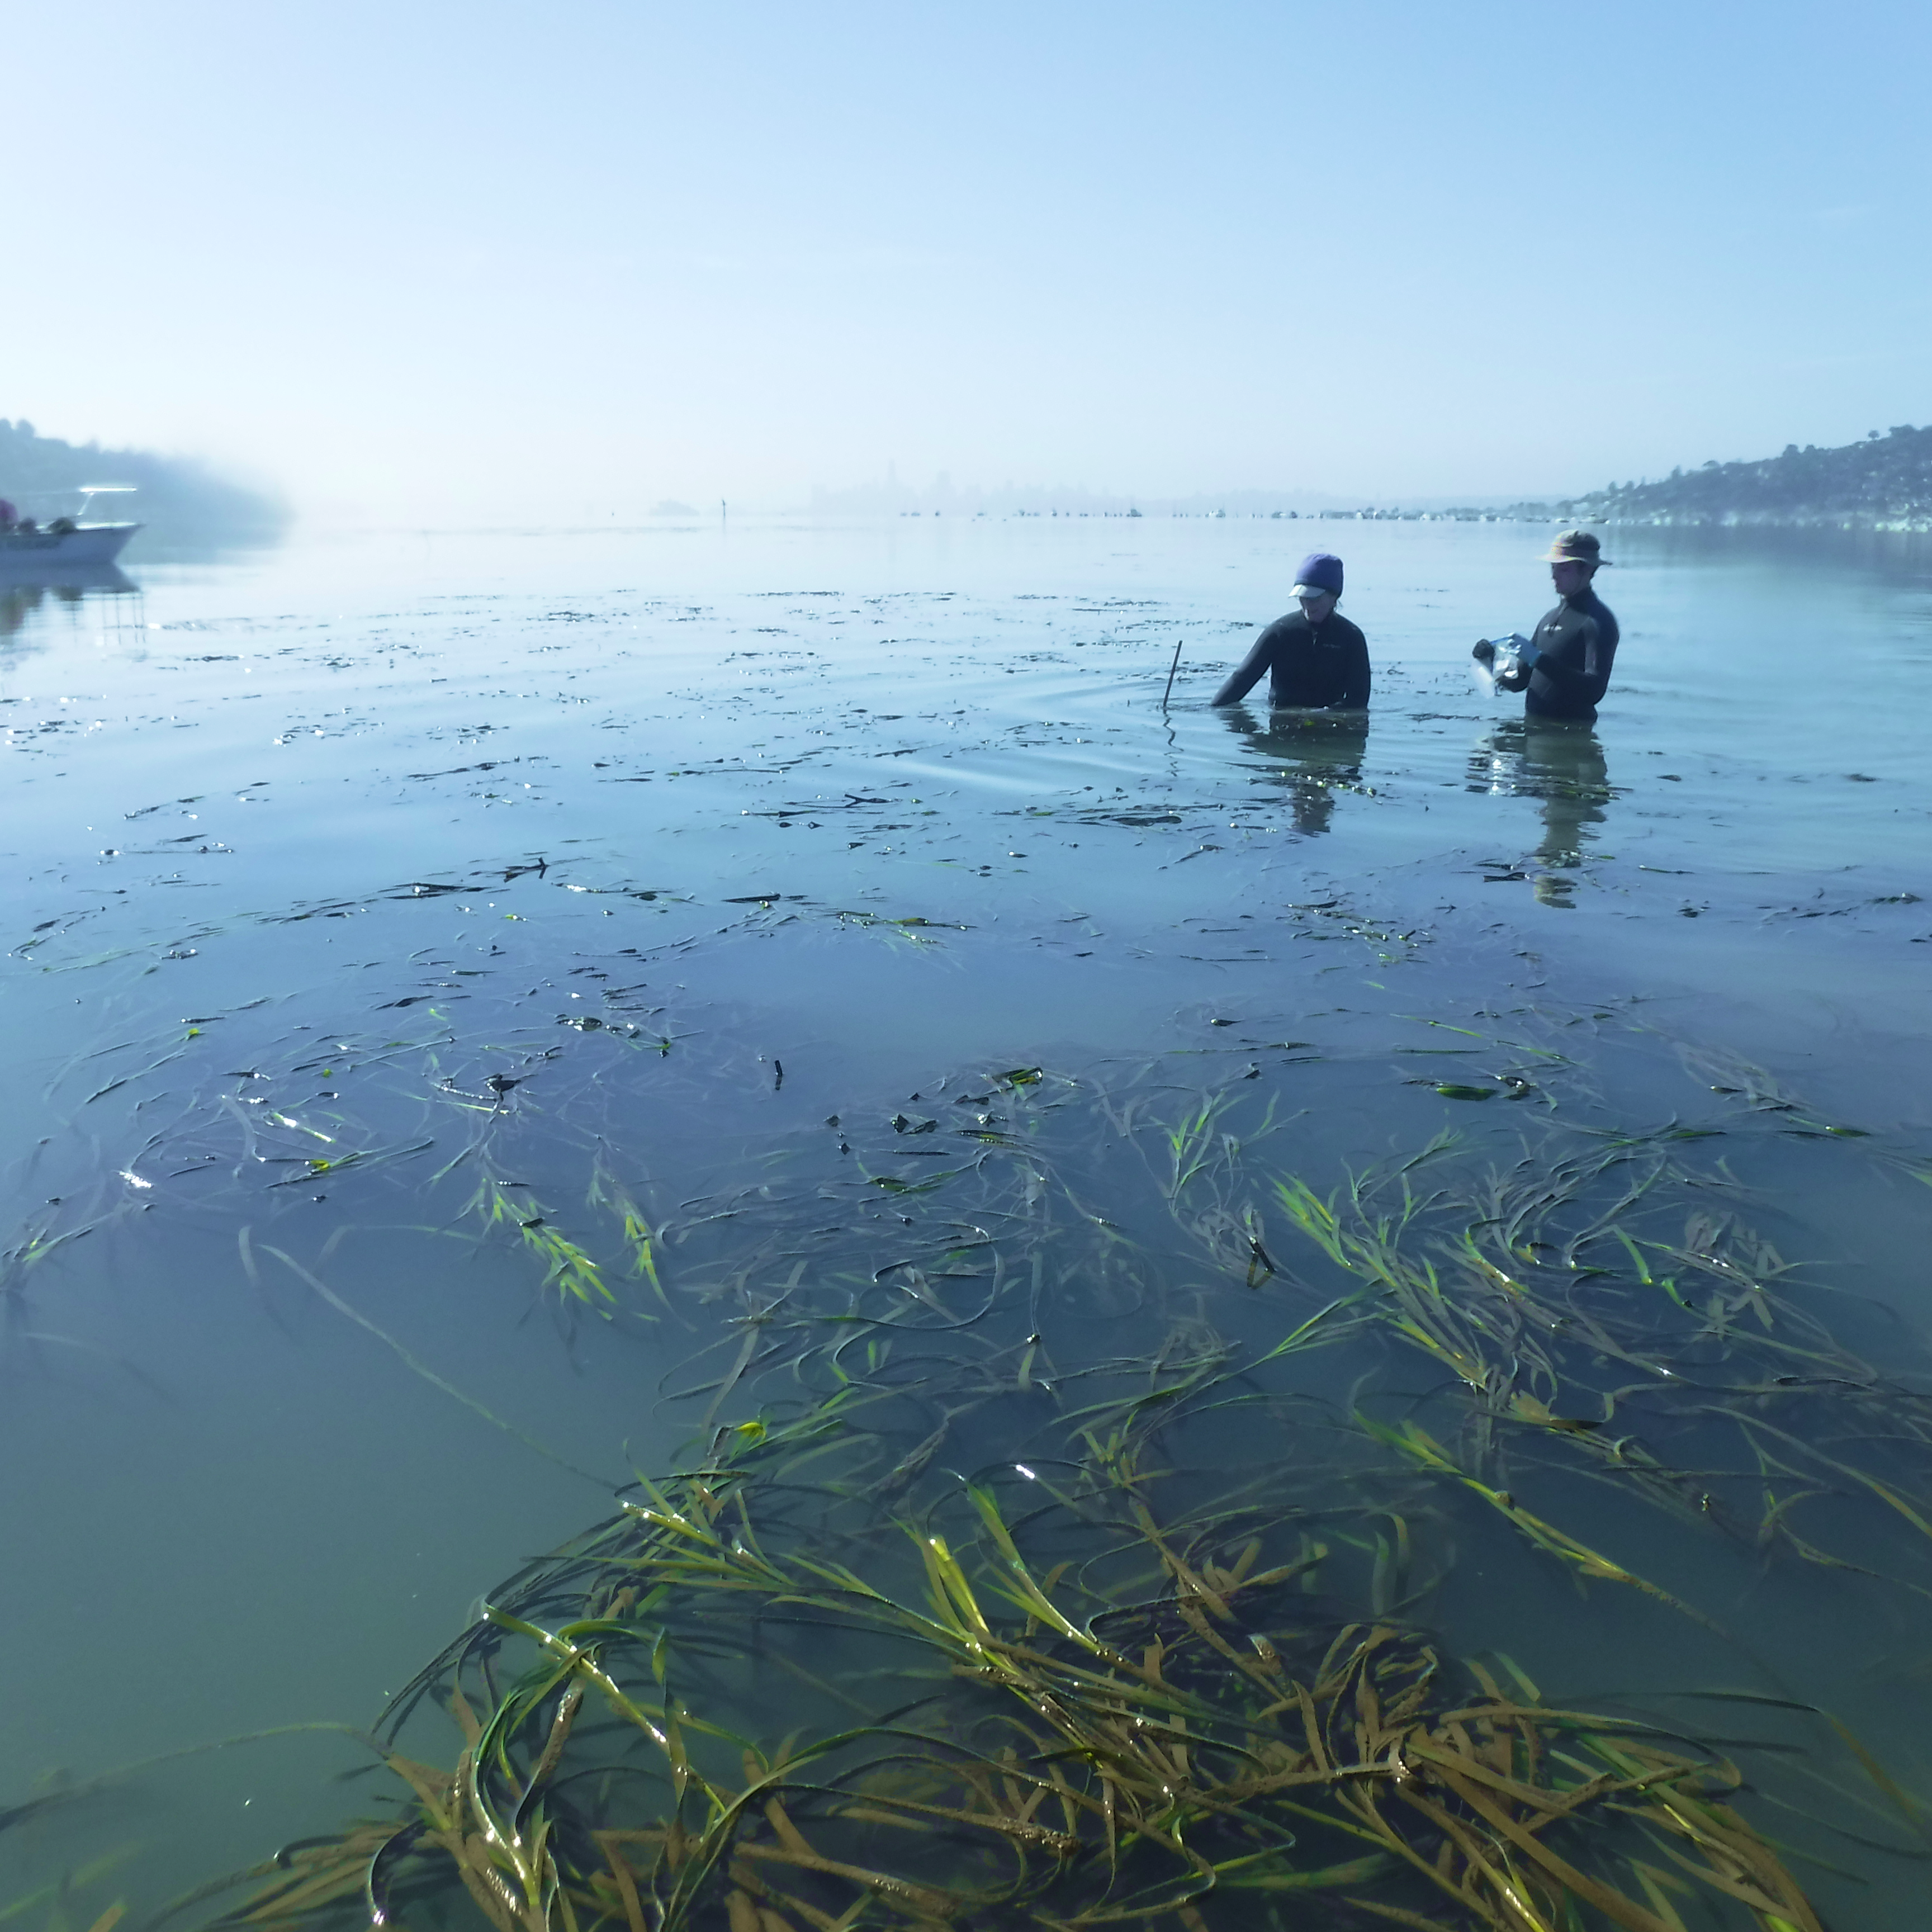
RBRA Update: EELGRASS
rbra.ca.gov
EPA Restoration Grant
Reminder: $2.8 million from US EPA’s SF Bay Water Quality Improvement Fund awarded to RBRA 5/5/23. Funds:
    Restoration and Adaptive Management Plan (RAMP) – due to BCDC by 12/15/23
    15 acres of eelgrass restoration by 2027
    Ongoing adaptive management
    Significant partner engagement/stakeholder outreach
Award for consultant services executed 9/14/23 with Coastal Policy Solutions and Merkel & Associates
    Services include project management, stakeholder engagement, policy support, and eelgrass restoration
In process: subawards to project partners SFSU Estuary & Ocean Science Center and Audubon California
Photo: Kathy Boyer

Slide 11
RBRA Update: EELGRASS
rbra.ca.gov
Restoration and Adaptive Management Plan (RAMP)
  On track for submittal to BCDC on 12/15/23
  Technical document:
    Describes 10-year adaptive management plan for restoration of 75 acres of eelgrass in RB
    Consistent with SF Bay Plan, RBRA Special Area Plan, California Eelgrass Mitigation Policy (CEMP)
    Considers beneficial reuse of dredge sediment
    Accounts for passive and active restoration of anchor scars
    Builds on results of ongoing restoration studies described at 8/23/23 BCDC Enforcement Committee meeting
  May be periodically updated in accordance with adaptive management and monitoring results
Photo: Kathy Boyer

Slide 12
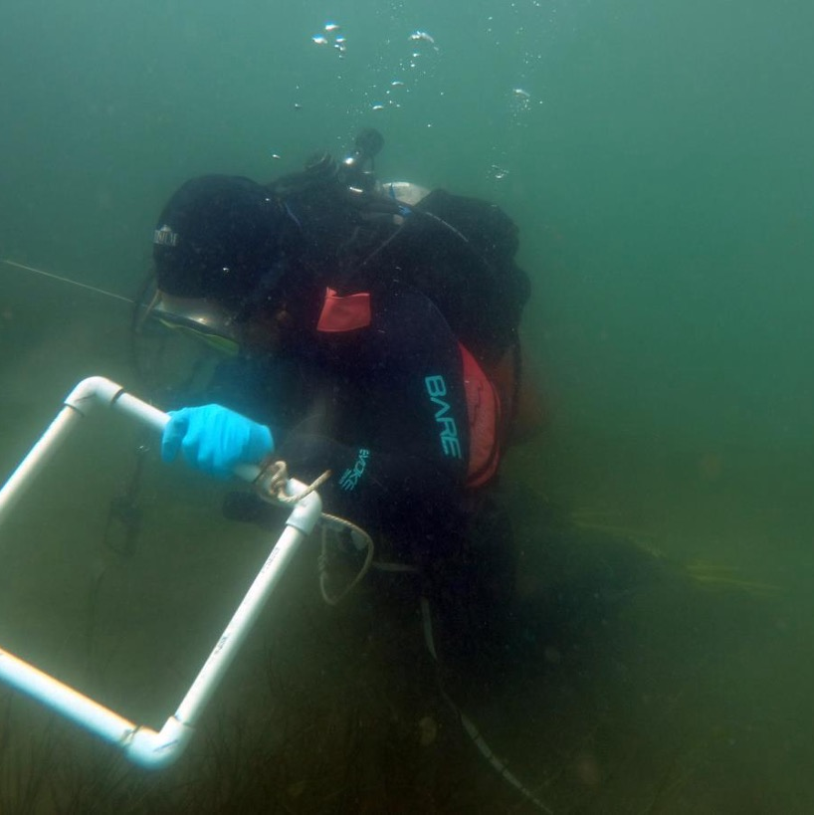
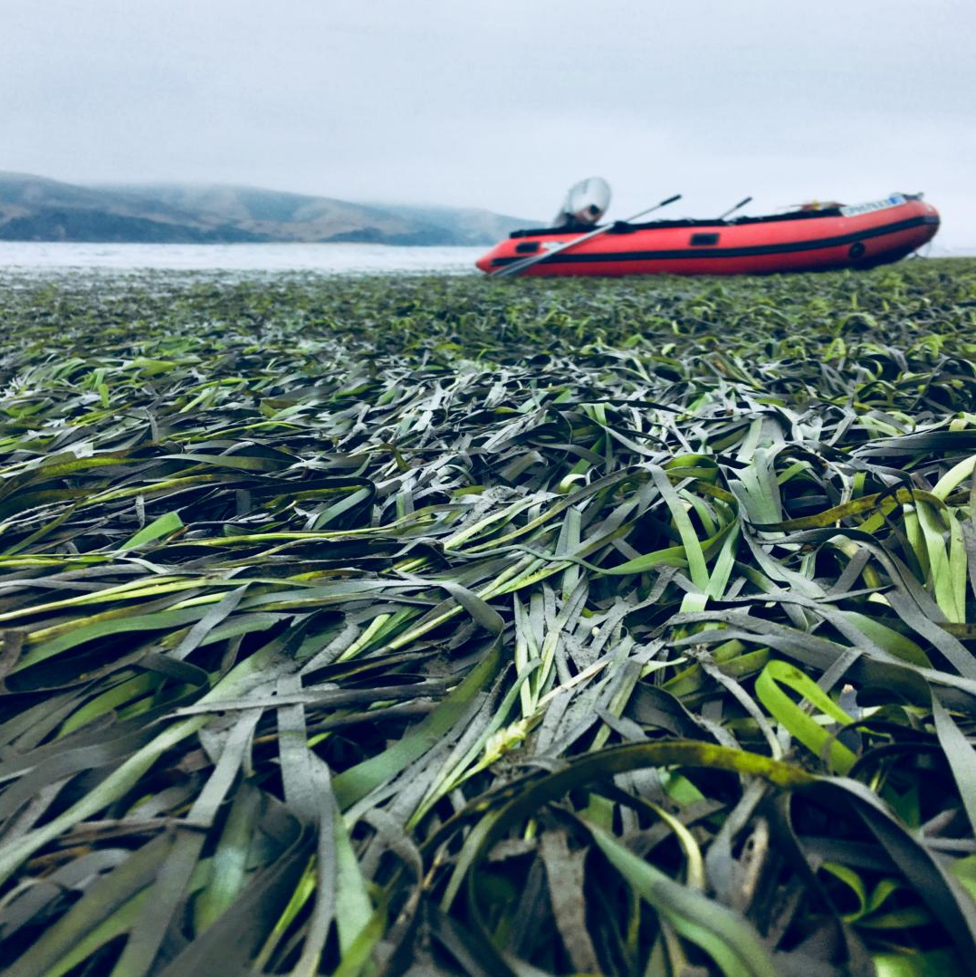
RBRA Update: EELGRASS
rbra.ca.gov
2023 Monitoring update
Presented by Coastal Policy Solutions to public and RBRA Board of Directors on 11/16/23
Includes:
    2022 Sidescan Sonar Survey
    2022 and 2023 Damage Surveys
    2022/2023 Waterbird Monitoring
    Major Takeaways
Photo: Melissa Ward

Slide 13
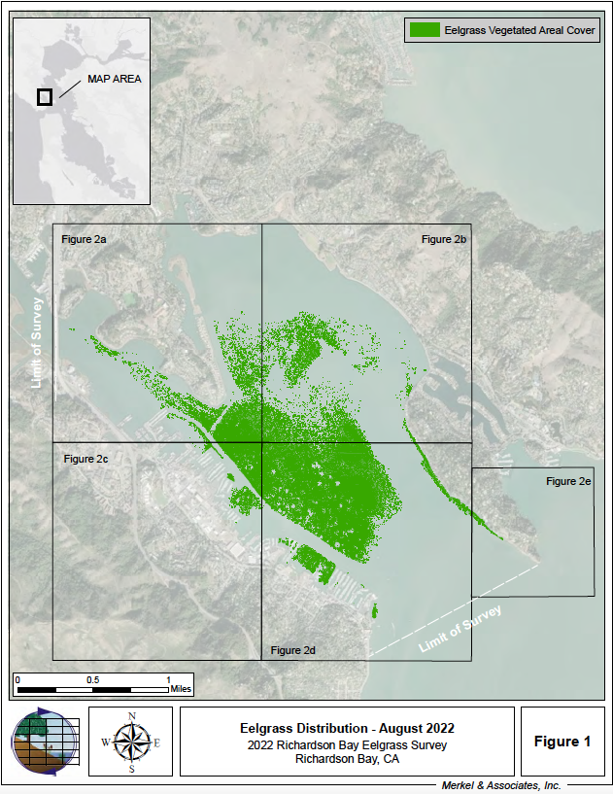
RBRA Update: EELGRASS
2023 Monitoring update:
1. Sidescan sonar survey
rbra.ca.gov
Method: boat-based sonar
Survey completed by Merkel and Associates
Same general pattern of eelgrass cover in RB as previous years
  Core of bed in central bay
  Present but less dense in shallows (warmer), some evidence of wasting disease
  Absent from deeper parts of the bay (approx. 5 feet MLLW), consistent with light limits

Slide 14
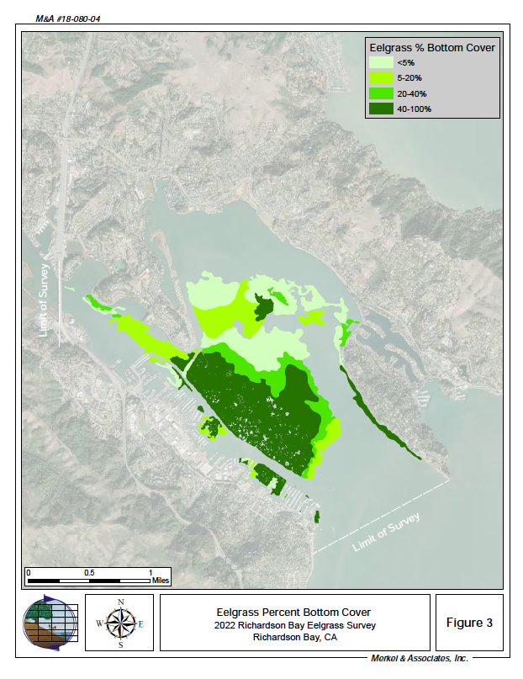
RBRA Update: EELGRASS
2023 Monitoring update:
1. Sidescan sonar survey
rbra.ca.gov
Total acres: 956.5 acres
Cover class: how dense the eelgrass bed is. Proxy for health.
Less than half in 40-100% cover class, over 25% in the <5% cover class

Slide 15
RBRA Update: EELGRASS
2023 Monitoring update:
1. Sidescan sonar survey
rbra.ca.gov
Binary change 2019 vs 2022:
    13% increase
    Within normal bed variability

Slide 16
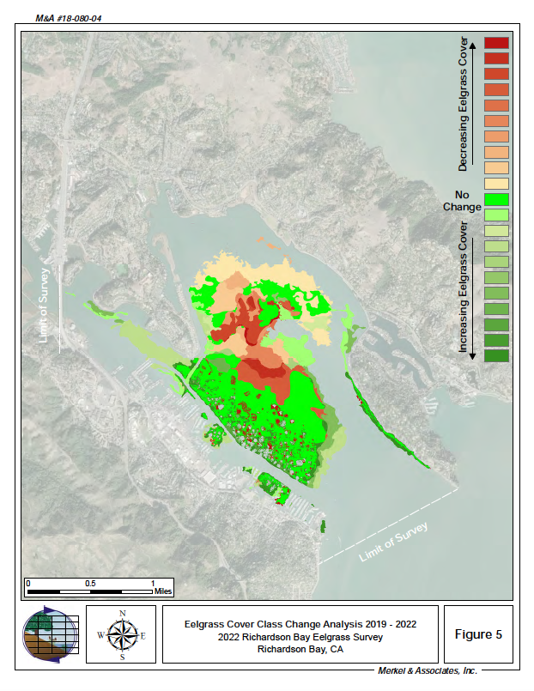
RBRA Update: EELGRASS
2023 Monitoring update:
1. Sidescan sonar survey
rbra.ca.gov
Closer look 2019 vs 2022:
    Some areas of expansion
    Some areas of decline
Likely causes of declines
    Northern reaches: thermal stress
    Loss in core: eelgrass wasting disease

Slide 17
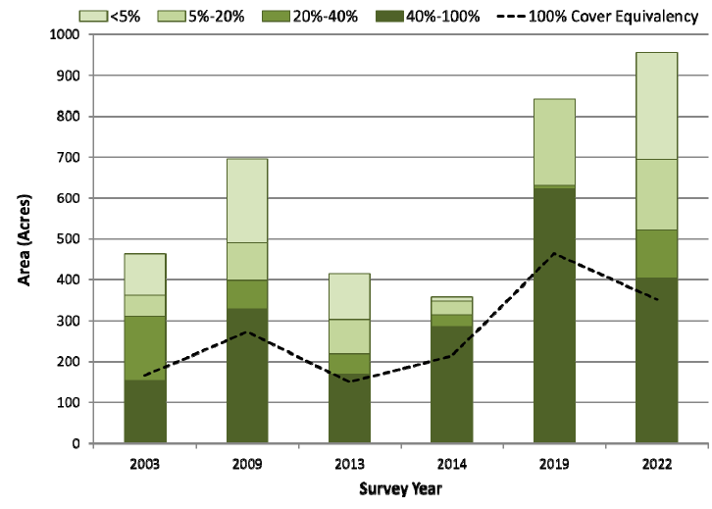
2023 Monitoring update:
1. Sidescan sonar survey
rbra.ca.gov
Biggest change: decline 2009 → 2013
Absolute cover: variable but generally increasing over the past 20 years
    20 years is NOT very long in the context of an eelgrass bed
100% cover equivalency:
    Definition: area that would be covered if all present eelgrass was at 100% cover
    Less dramatic increase since 2003
    Declined by 24.2% between 2019-2022
    Better indicator of bed health
        Beneficial when evaluating:
        Eelgrass bed productivity
        Biomass
        Other metrics dependent on plant density, (e.g., carbon cycling and storage)

Slide 18
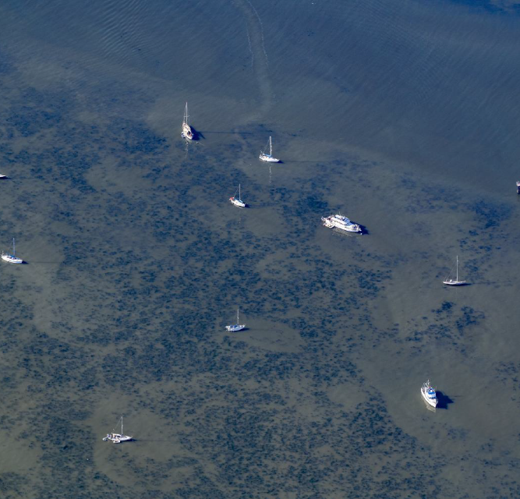
2023 Monitoring update:
2. Damage assessments
rbra.ca.gov
Method: aerial photography and GIS analysis
    Photos by 111th Aerial Photography Group
    Analysis and report by Audubon CA
Goal: How much eelgrass is damaged by anchor scour? Does eelgrass recover within an anchor scar?
Scour – damage from anchors, chains, other ground tackle
Methods repeated from previous study (Kelly et al. 2019)
Low and high damage estimates
Photo: 111th Group, courtesy Audubon CA

Slide 19
Summer 2022 aerial view of Richardson Bay. Photo courtesy of the 111th Air Squadron Photography.
SUMMER 2022 Aerial View of Richardson Bay

Slide 20
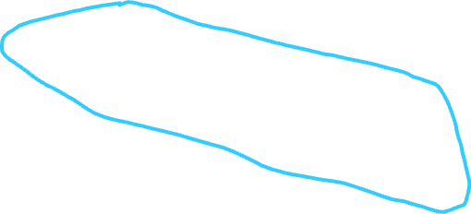
Summer 2022 aerial view of Richardson Bay. Photo courtesy of the 111th Air Squadron Photography.
SUMMER 2022 Aerial View of Richardson Bay

Slide 21
2023 Monitoring update:
2. Damage assessments
rbra.ca.gov
Photo: 111th Group, courtesy Audubon CA

Slide 22
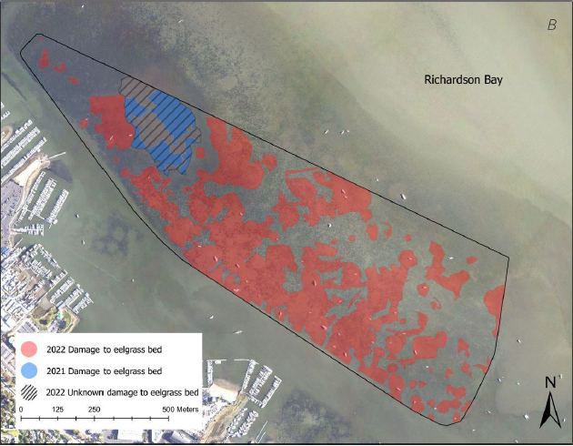
2023 Monitoring update:
2. Damage assessments
rbra.ca.gov
2022 survey:
    Assessment influenced by area of unknown damage, suspected harmful algal bloom

Slide 23
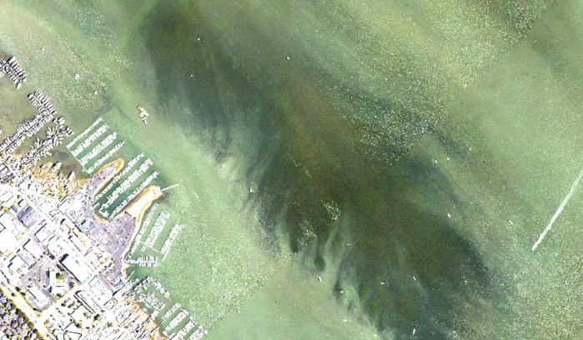
2023 Monitoring update:
2. Damage assessments
rbra.ca.gov
2023 survey:
    Assessment not possible due to macroalgal mat obscuring the eelgrass bed from view

Slide 24
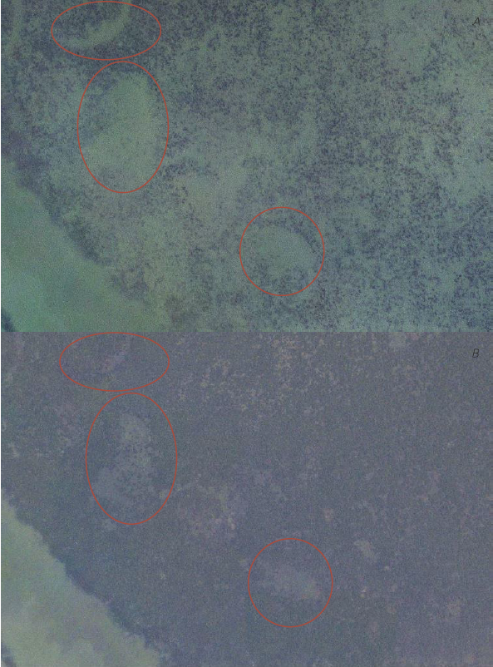
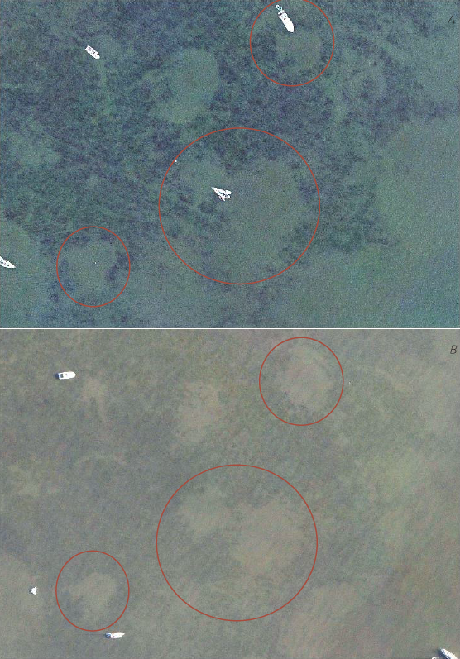
2023 Monitoring update:
2. Damage assessments
Additional findings:
    Some, but not all, anchor scars show signs of recovery
    Suggests recovery takes more than one year
rbra.ca.gov
Recovery
No Recovery
2021
2021
2022
2022

Slide 25
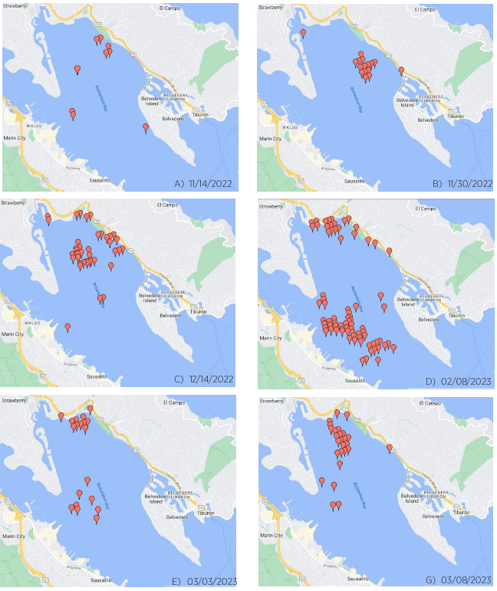
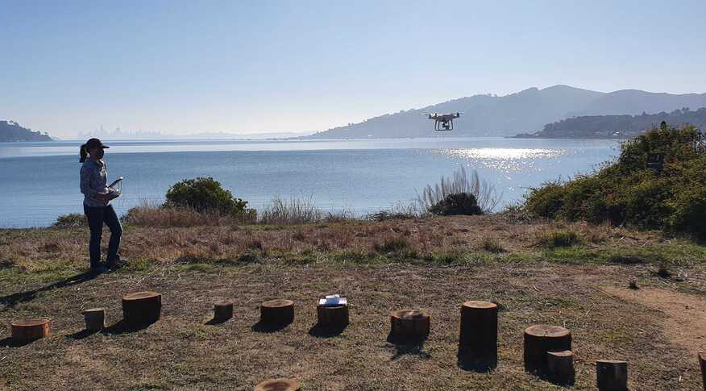
2023 Monitoring update:
3. Waterbird monitoring
rbra.ca.gov
Results:
    Continue to see rafts primarily along northern and eastern shorelines, same as previous years.

Slide 26
RBRA Update: EELGRASS
2023 Monitoring update
rbra.ca.gov
Major takeaways
The good:
    Damage to eelgrass from anchor scour appears to have plateaued
    Continue to see evidence of eelgrass recovery
The not so good:
    Overall health of the bed is questionable
    Thermal stress, wasting disease, algal competition - all expected to increase with climate change
Overall:
    Protecting and restoring this bed is more crucial than ever
Photo: Melissa Ward

Slide 27
VESSEl CENSUS
rbra.ca.gov

Slide 28

Vessel CENSUS
rbra.ca.gov
Milestones in Agreement
Milestones in Agreement
10/15/23: all post 2019 vessels
14 as of 8/10/23
      7 as of 12/4/23
10/15/23: all floating homes
2 as of 8/10/23
      1 as of 12/4/23
10/15/24: no vessels in EPZ
53 as of 7/1/22
42 as of 8/10/23
      35 as of 12/14/23
10/15/26: all occupied, safe and seaworthy
10 as of 6/1/22
7 as of 8/10/23
  7 as of 12/4/23
Vessels on the water
57 as of 7/1/22
48 as of 8/10/23
  43 as of 12/14/23
  5 – 30 day permits as of 12/14/23

Slide 29
ENFORCEMENT:
rbra.ca.gov
6 citations issued during this reporting period. 3 initial, 2 second and one third notice
Two nuisance abatement issued and in process during this reporting period.
All vessels due to vacate the anchorage by 10/15/24 were issued a 12-month advance notice

Slide 30
ENFORCEMENT: NEXT STEPS
rbra.ca.gov
Planning underway for EPZ and Anchorage signage
5 Signs to be placed on existing piles
Installation of one new pile and three floating buoys
Plans are under review by BCDC staff
Permits are not yet submitted
Effective date 10/15/24
All vessels in EPZ received a 12-month notice to vacate Richardson Bay

Slide 31

RBRA UPDATE: HOUSING
rbra.ca.gov
Components
Funding
Funding
Temporary housing support
Case Management
Marinas
$3 million FY 23 State budget
  With thanks to Senator McGuire for his support
Funding received 3/28/23
Program began seeking applications on 5/1/23
To date, $182,326.00 has been expended

Slide 32
RBRA UPDATE: HOUSING
rbra.ca.gov
Housing Cont’d…
TEMPORARY Housing Support
RBRA/Marin Housing Authority contract approved by RBRA 11/10/22, by MHA 1/31/23
MHA prefunded $30,000
Contract between RBRA and HHS approved 4/18/23, and prefunded $86,170
Contract between HHS and Episcopal Community Services for case management was approved 8/15/23
ECS has established well received landside meeting dates in Sausalito and recently began their on the water outreach efforts.
ECS full time case worker began on 10/2/23

Slide 33
RBRA UPDATE: HOUSING
rbra.ca.gov
MArINAs
Activities during reporting period
No formal commitments from Sausalito Marinas yet
Two marinas have engaged, and discussions continue
One marina is now committed
One marina withdrew participation

Slide 34
TRAcking post-2019 vessels
rbra.ca.gov
Name | CF or USCG | Vessel Type | Registration | In EPZ Y/N | Occupied Y/N | 30-Day Permit | Housed | Note
CF 9 | CF | power | 2019 | Y | N |  |  | Engaged
CF 4 | CF | sail | none | Y | N |  | Y | Vessel Gone
CF 6 | CF | sail | 2017 | Y | Y
F | CF | sail | 2017 | Y | Y |  |  | Engaged
L | CF | sail | 2021 | Y | Y
S1 | DOC | sail | 2019 | Y | Y |  |  | Engaged
Z | CF | sail | 2021 | Y | Y |  |  | Engaged
I | CF | motor | 2013 | Y | Y |  | Y | Vessel Gone
S2 | none | sail | none | Y | Y |  | Y | Vessel Gone
CF 3 | CF | sail | 2015 | Y | Y
NN | none | power | none | Y | Y |  | Y | Vessel Gone
G | CF | power | 2023 | Y | Y | x |  | Engaged
ND | CF | Sail | 2023 | Y | N | x |  | Engaged
J | CF | Sail | 2023 | Y | Y | x |  | Engaged
K | none | Sail | none | Y | Y |  |  | Engaged
 | Housed | On path to | Participating | Slated for | 30-day | Pending | Housed
 |  | Housing | in Program | outreach | permit | Buyback
Current rept period | 2 | 10 | 10 | 3 | 3 | 3 | 2
Previous rept period | 2 | 3 | 9 | 6 | 3 | 2 | 2
RBRA Program | 3 |  | Vouchers issued 6
Other Program | 1
 |  |  | Housed | 4 |  | Vessel Buyback 4

Slide 35
Program Success
rbra.ca.gov
TEMPORARY HOUSING VOUCHER Program Past activities
TEMPORARY HOUSING VOUCHER Program
4 boaters are participating
11 boaters are in queue to participate
3 boaters have had vouchers issued (2 RBRA THV)
2 boaters have submitted rental applications
3 vessels have been purchased via the Vessel Buyback Program
4 persons are housed
10 persons are participating
5 persons are in queue to participate
2 persons have a voucher and one pending
4 vessels have been purchased via the Vessel Buyback Program

Slide 36
Vessels vs. Housing
 | May-23 | Jun-23 | Jul-23 | Aug-23 | Sep-23 | Oct-23 | Nov-23 | Dec-23 | Totals
Vessels | 49 | 48 | 48 | 47 | 46 | 44 | 42 | 41 | 41
Floating homes | 3 | 3 | 3 | 3 | 3 | 2 | 2 | 1 | 1
Combined Vessels and FH | 52 | 51 | 51 | 50 | 49 | 46 | 44 | 43 | 43
Vessels Turned In | 1 | 1 | 0 | 0 | 1 | 3 | 1 | 0 | 7
FH Turned In | 1 | 0 | 0 | 0 | 0 | 1 | 0 | 1 | 3
Total vessels & FH turned in | 1 | 1 | 0 | 0 | 1 | 4 | 1 | 1 | 9
Total Persons Housed | 0 | 0 | 0 | 0 | 0 | 4 | 4 | 4 | 4
Persons With Vouchers | 0 | 0 | 0 | 0 | 3 | 0 | 1 | 2 | 6

Slide 37

THANK YOU
rbra.ca.gov
Brad Gross, Executive Director bgross@rgs.ca.gov

